Slide 1


Khelo MATE
GB-05

Slide 2


Team memeber
SUPERVISIOR
Ms Divya Singhal
Aman Kumar Sharma(2200290140025) Aman Chaudhary (2200290140022)
Abdul wali khan (2200290140004)

Slide 3





Introduction,
Hello, outdoor enthusiasts! Welcome to Khelo Mate, your go-to destination for connecting with fellow game lovers in your area. Whether you're into basketball, soccer, or simply want to go for a jog, Khelo Mate is here to help you find like- minded individuals nearby who are eager to join in on the fun. Powered by advanced geolocation technology, our platform makes it easy to discover and organize outdoor game sessions effortlessly. So, lace up your sneakers, grab your gear, and let's make some memories together on Khelo Mate!"

Slide 4










Hardware REQUIREMENT
Processor: Intel Core i3/i5/i7
MEMORY: 4GB/64GB
Storage SYSTEMS
Network Interface: Gigabit Ethernet

Slide 5



technologies & Software requirements
shuttlecock
HTML/CSS/JavaScript
FireBase
Express.js
REACT
NODE.JS
racket

Slide 6
Progress Report

Slide 7
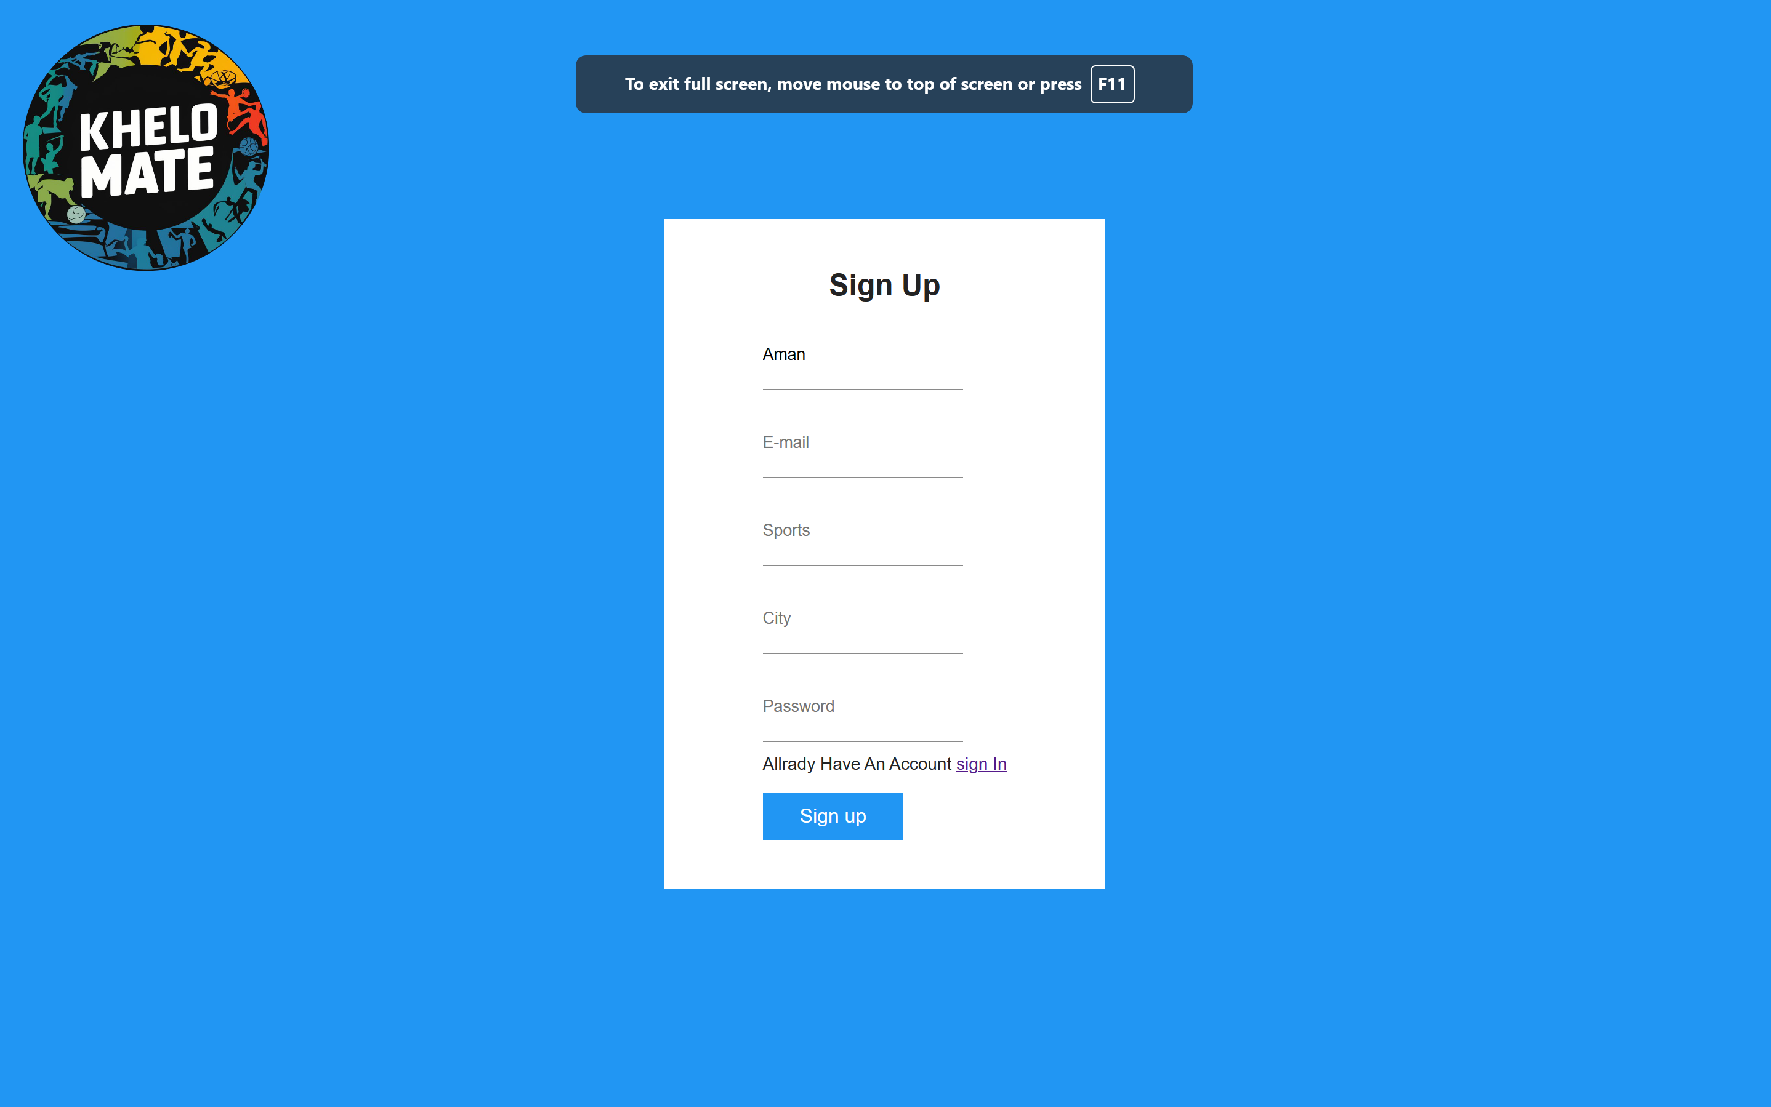

Slide 8


Slide 9

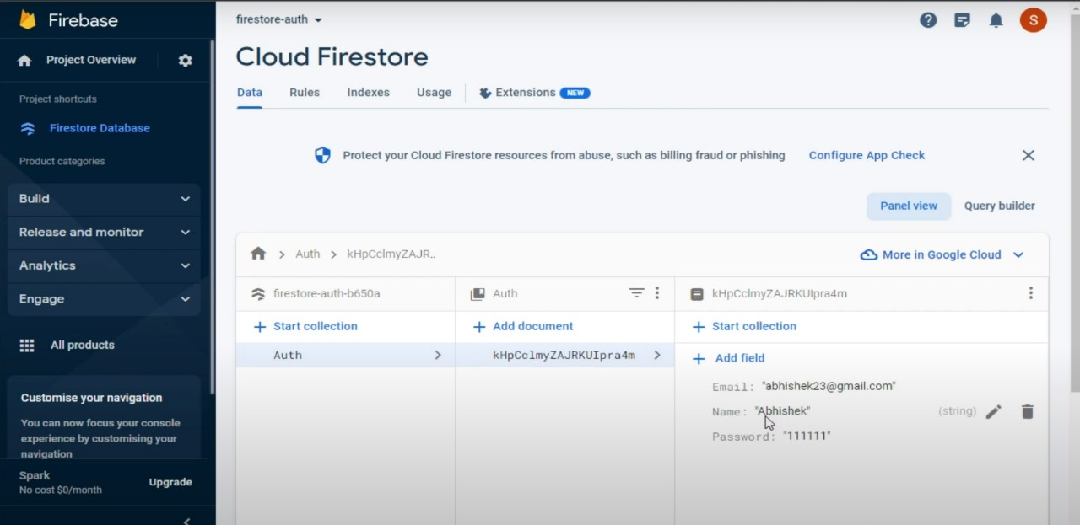

Slide 10
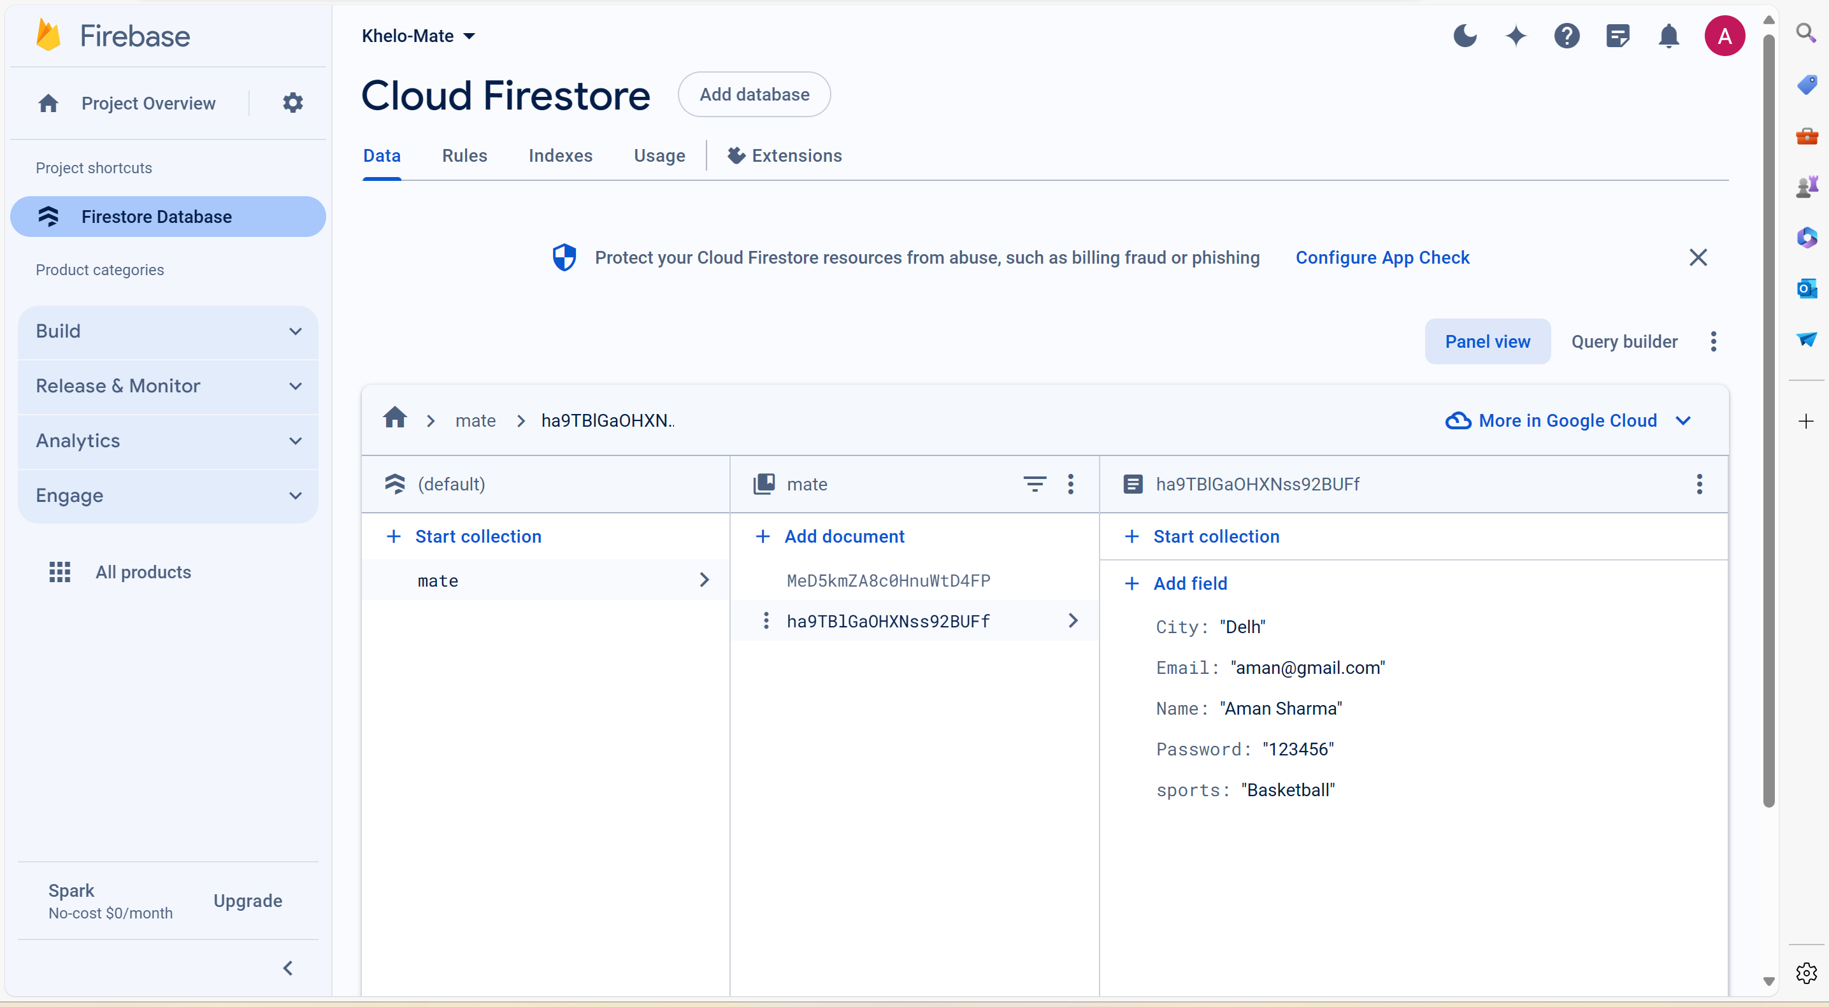


Slide 11


Slide 12
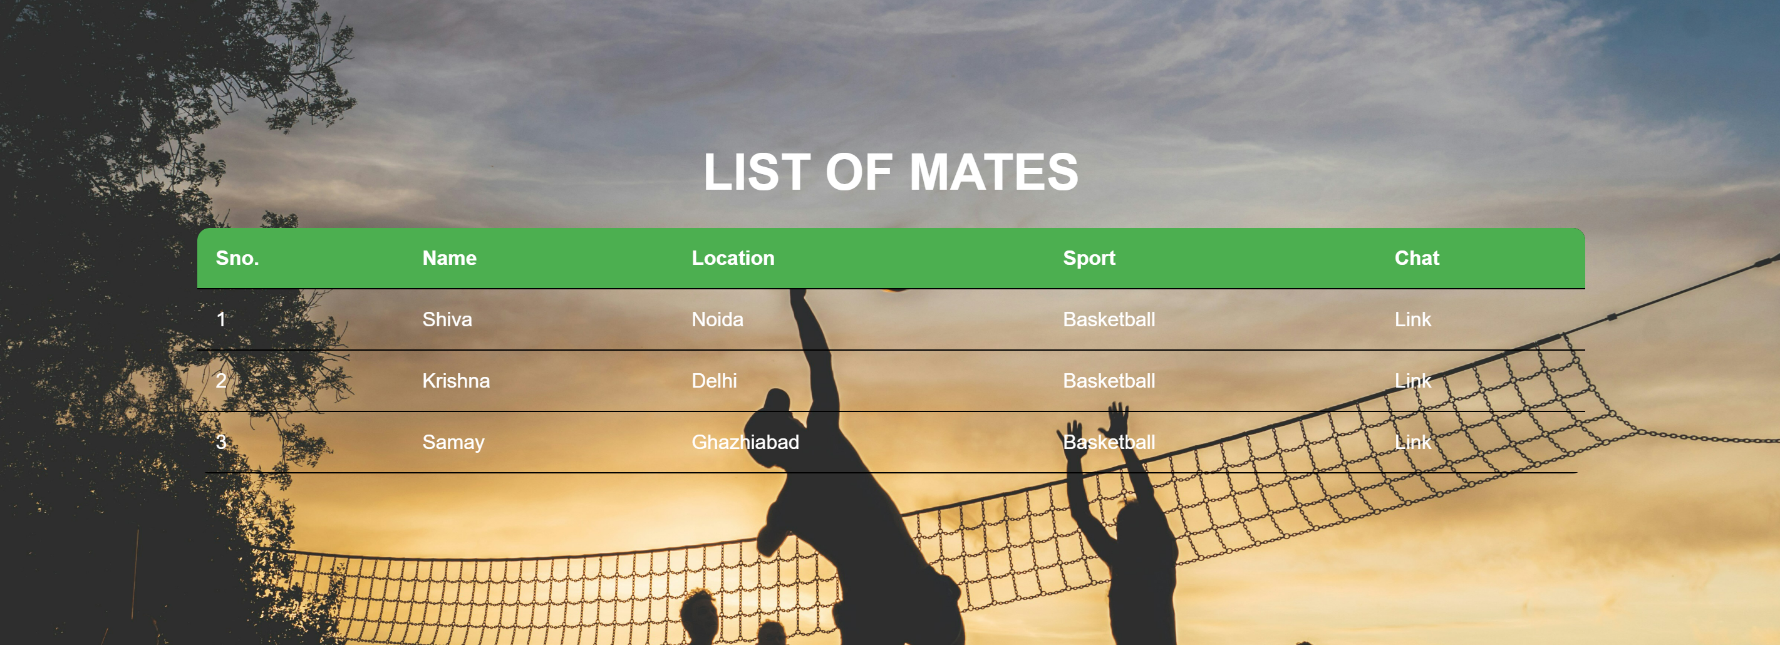

Slide 13


Conclusion
Khelo Mate has revolutionized outdoor gaming, fostering connections and enriching experiences. With seamless functionalities, positive feedback, and robust performance, we've created a thriving community. As we look to the future, our commitment to enhancing features and engagement remains steadfast. Thank you for joining us on this journey. Let's continue playing, connecting, and thriving together on Khelo Mate.

Slide 14




Thank You For Your attention

